Slide 1
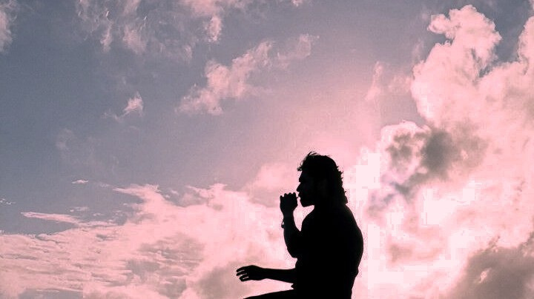
DIGITAL PORTFOLIO
STUDENT NAME: Jeevanandham.S
REGISTER NO AND NMID: 2422k1873 / asbru062422k1873
DEPARTMENT: Bsc.Computer Science
COLLEGE: Chikkanna Govt Arts College/ Bharathiyar University
1

Slide 2
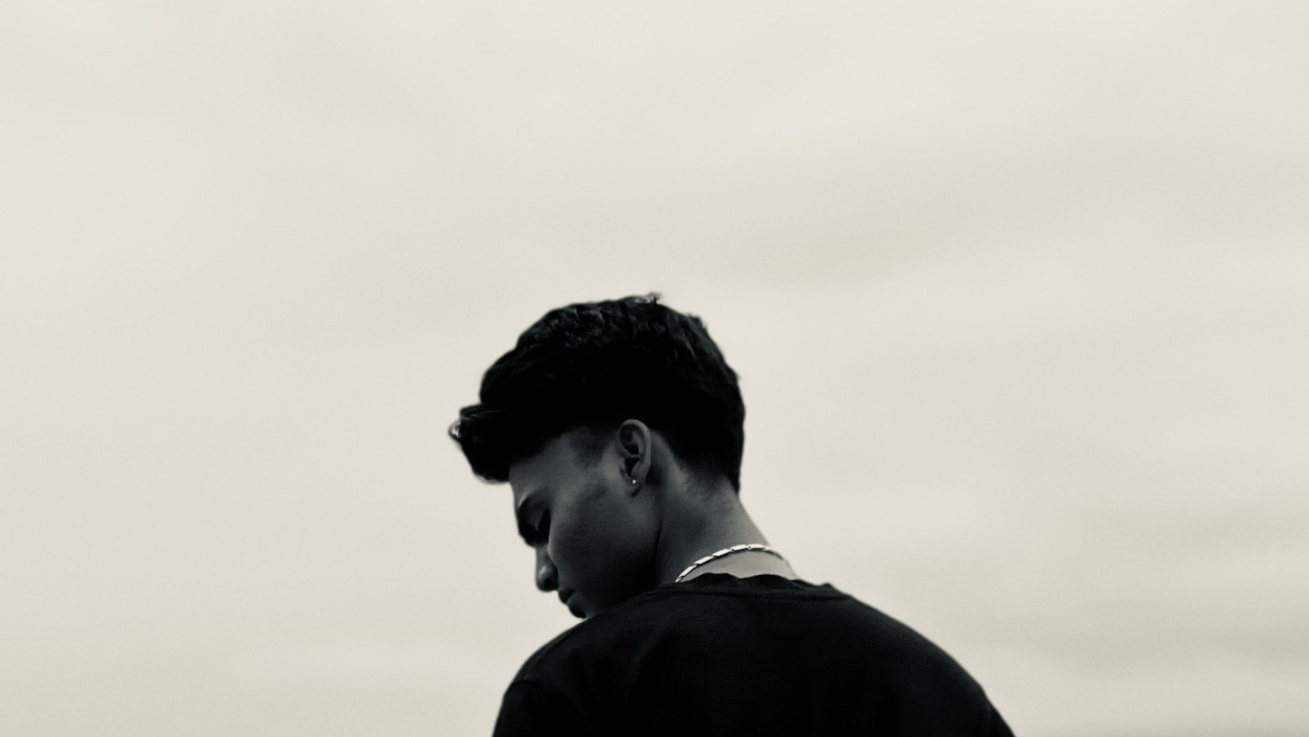
PROJECT TITLE
Digital Portfolio
1

Slide 3
AGENTA
Problem Statement
Project Overview
End Users
Tools and Technologies
Portfolio design and Layout
Features and Functionality
Results and Screenshots
Conclusion
Github Link
3/21/2024 Annual Review
1

Slide 4
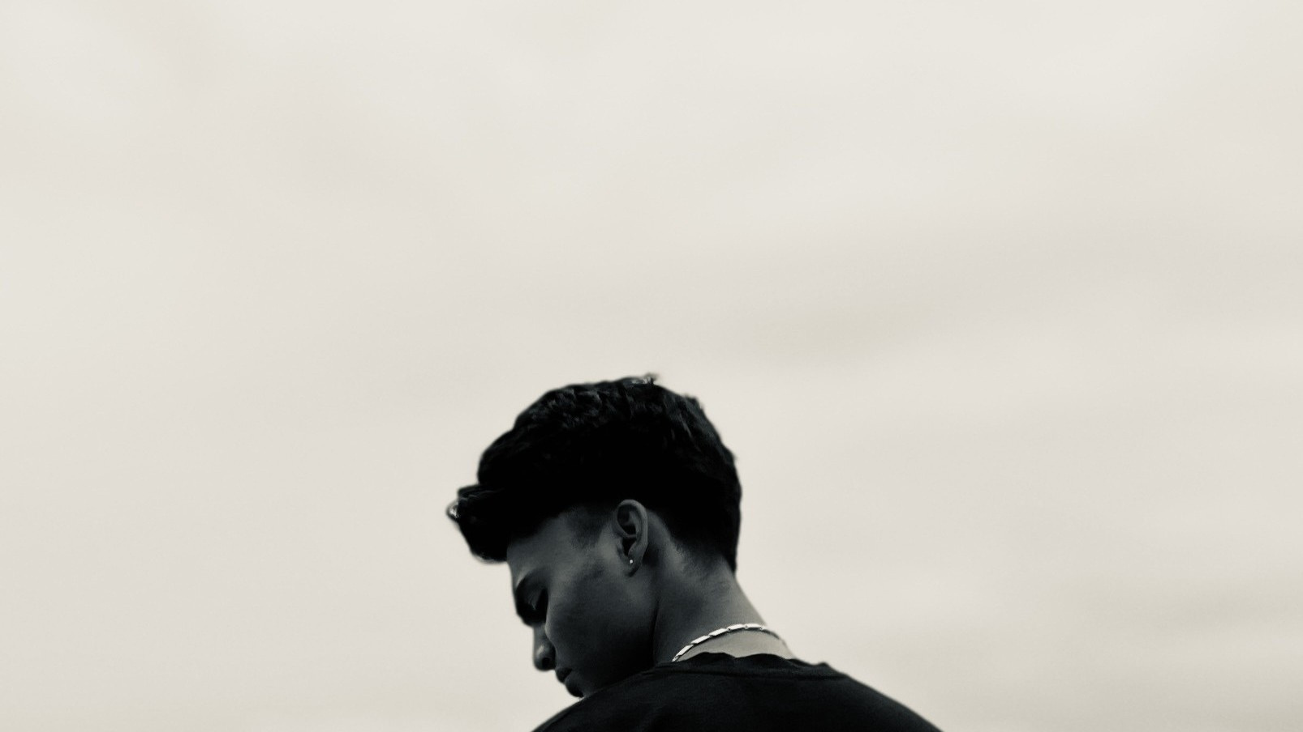
PROBLEM STATEMENT
In the digital era, professionals need an online presence to showcase their work, skills, and contact details. A static portfolio website serves as a digital resume that allows potential employers, clients, and collaborators to easily learn about the person and their expertise.
1

Slide 5
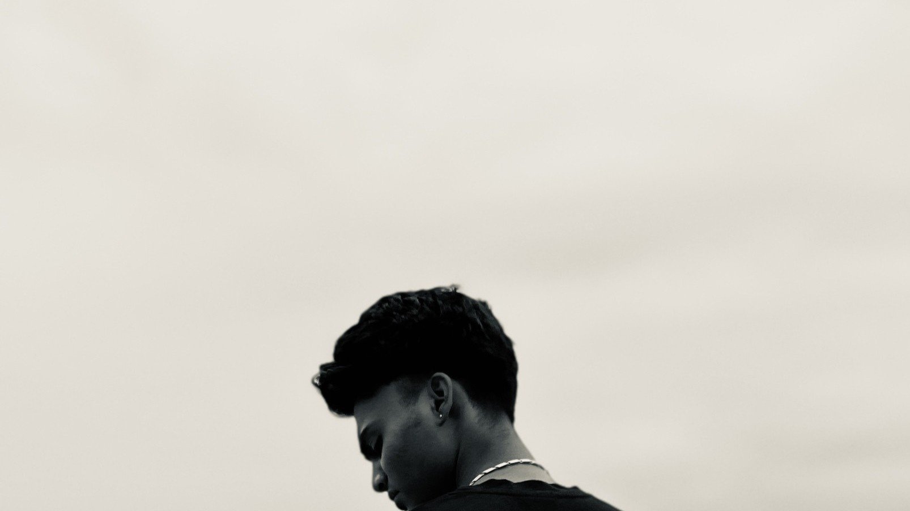
PROJECT OVERVIEW
This project is a personal portfolio website for Jeevanandham.S, designed using HTML and CSS only. It highlights professional details such as profile photo, tagline, skills, projects, and contact information in a clean, modern, and responsive layout.

Slide 6

WHO ARE THE END USERS?
Hiring managers/recruiters – to check skills and projects.
Clients – to explore creative design services.
Peers and collaborators – to connect and work together.
General audience – to know more about the person.
6

Slide 7

TOOLS AND TECHNIQUES
HTML5 – for the structure of the website.
CSS3 – for styling, gradients, layout, and responsiveness.
Postimg.cc – for hosting the profile image.
Web browser – to run and test the website (Chrome, Edge, Firefox, etc.).
6

Slide 8
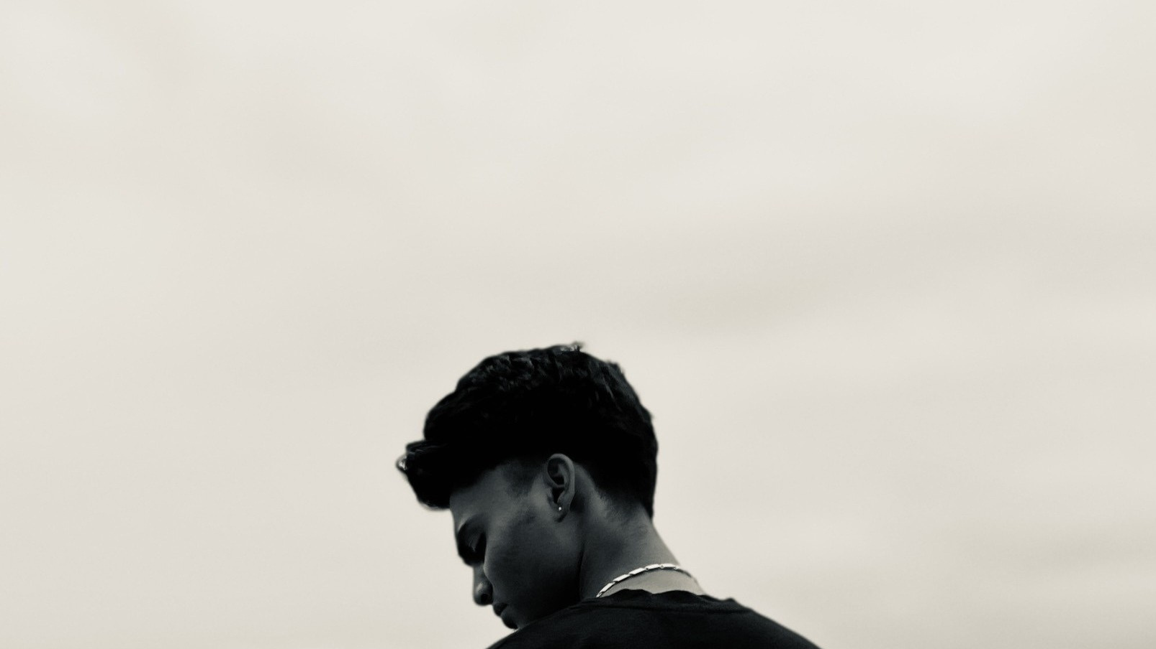
POTFOLIO DESIGN AND LAYOUT
Background – gradient with dark theme (#0d0d0d → #1a1a1a → #001f3f).
Container – centered card layout with rounded corners and shadows.
Profile Section – circular profile photo with glowing border and name + tagline.
Sections – About Me, Skills, Projects, Contact, and Footer.
Color Scheme – Blue (#007bff, #00aaff) as highlight over a dark background.
Typography – clean font ("Segoe UI", Tahoma, Verdana).
6

Slide 9
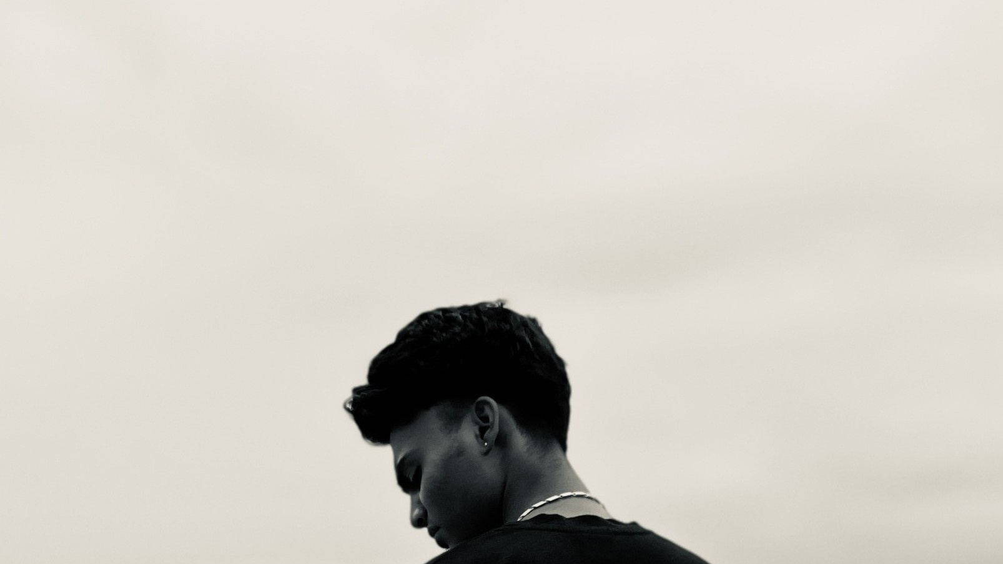
FEATURES AND FUNCTIONALITY
* Profile photo with border glow
*About Me section – brief introduction
* Skills section – listed inside stylized blue tags
* Projects section – placeholder for future works
* Contact section – email (click-to-mail) & phone (click-to-call) links " Footer – copyright information
* Responsiveness
*layout – adjusts for different screen sizes

Slide 10

RESULTS AND SCREENSHOTS
When opened in a browser, the website displays:
A dark professional-themed portfolio with glowing blue accents.
A profile photo in the center with the name & tagline.
Sections for About, Skills, Projects, and Contact details neatly separated.
(Here, in a real report you would insert screenshots of the webpage opened in desktop & mobile view.)

Slide 11
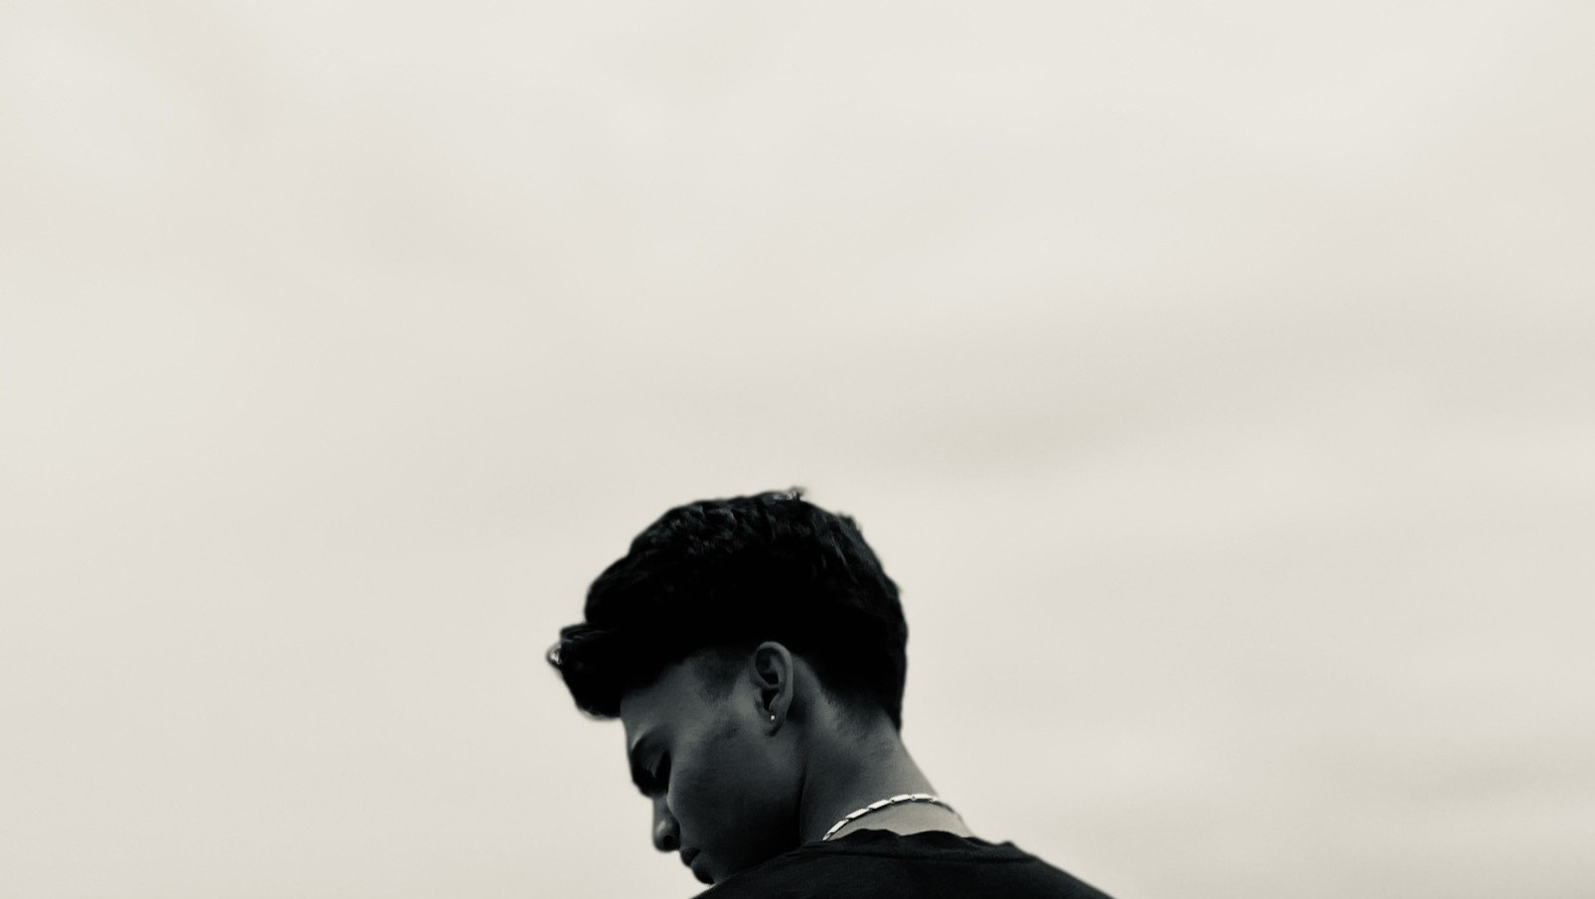
CONCLUSION
The portfolio project demonstrates how a simple yet elegant website can be built using only HTML and CSS. It provides a professional digital identity for Jeevanandham.S, showcasing both artistic and technical skills. The design is minimalistic but effective, with scope to expand (add projects, animations, and links to social media or GitHub).
11

Slide 12
GitHub Link
https://github.com/jeevanandham-0/Jeevanandham.S-TNSDC-FWD-DP.git

